Slide 1
DSA
-
Deep Learning [2]
Advanced Neural Networks, Part 1

Slide 2
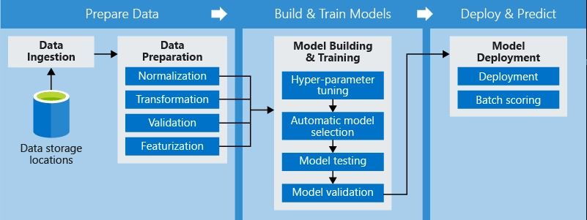
Firstly, a recap on the ML pipeline

Slide 3
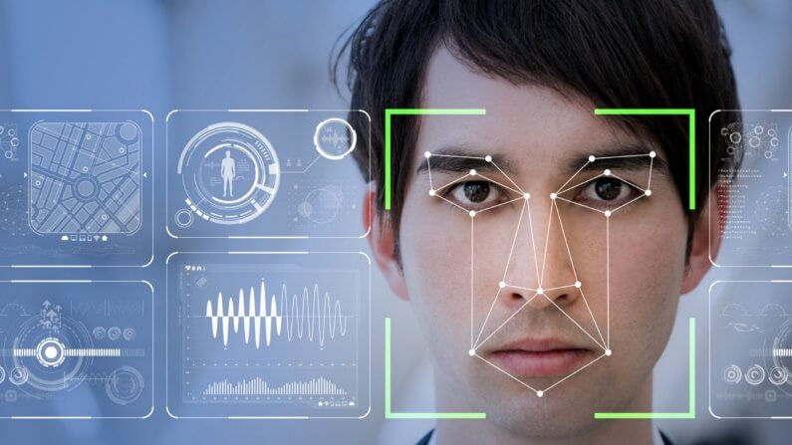
Goal: code a Neural Network to recognize facial expressions using our webcam

Slide 4
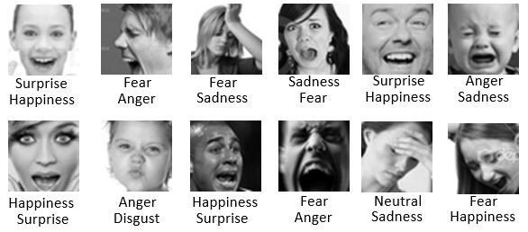
Dataset: FER-2013

Slide 5
Let’s CODE!!!

